Slide 1
Asynchronous Online Federated Learning for Edge Devices with Non-IID Data
데이터 응용 및 관리 연구실
학부생 연구원 김민선

Slide 2
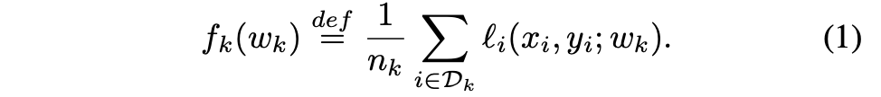
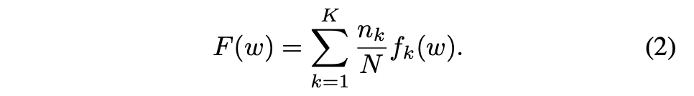
BACKGROUND
Fed-AVG Algorithm

Slide 3
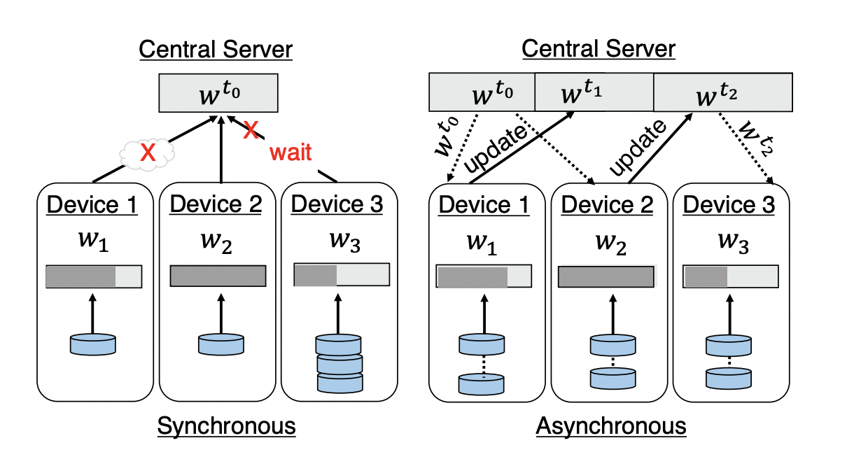
INTRODUCTION
ASO-Fed

Slide 4
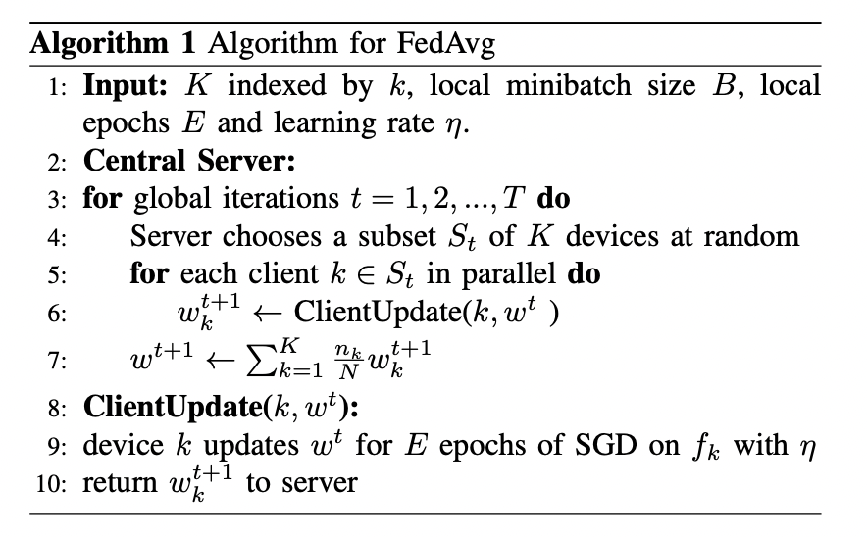
SYNCHRONIZED FEDERATED OPTIMIZATION
Large epochs -> towards the local objective optima
Continuous data -> the increase of local gradient variations

Slide 5
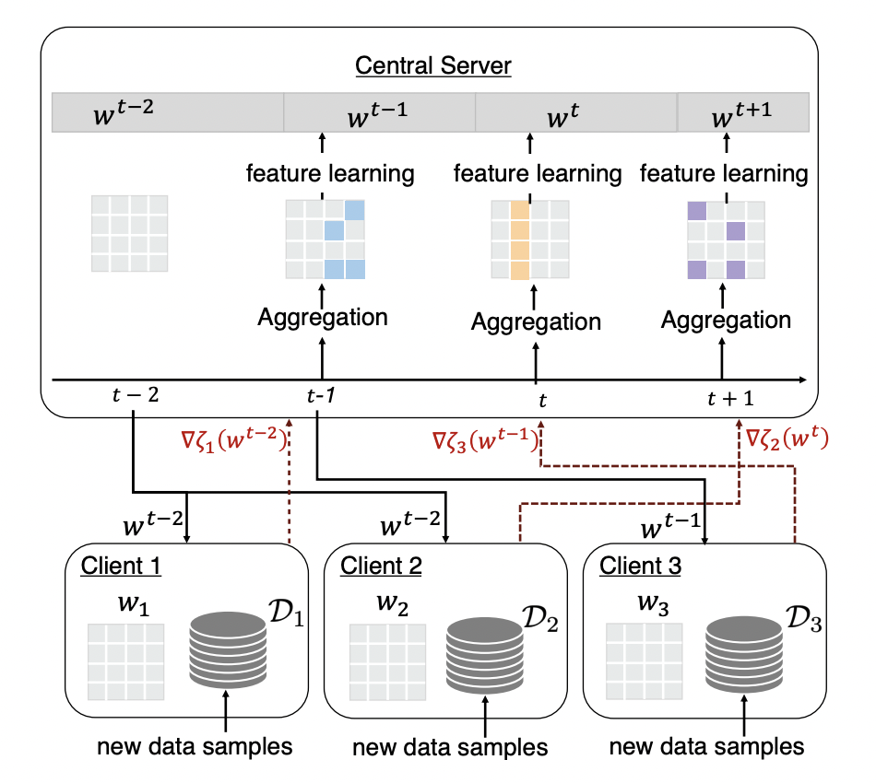
PROPOSED METHOD
Decay Coefficient
Global feature representation (Dynamic Step Size)

Slide 6
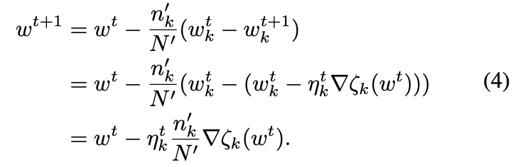
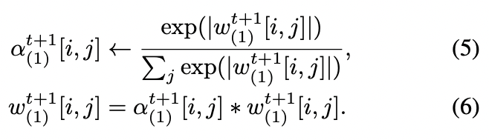
CENTRAL SERVER
Overall Training Procedure
Feature Representation Learning on Server

Slide 7
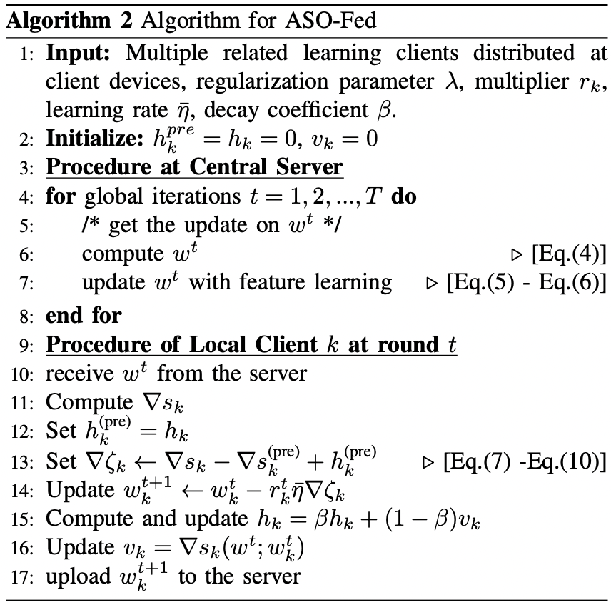
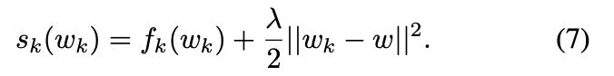
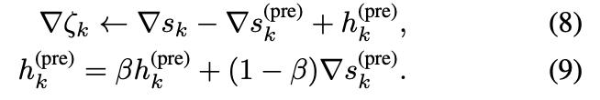
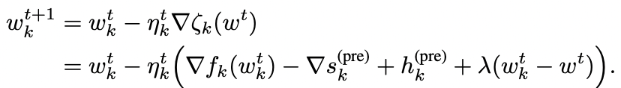
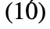
LOCAL CLIENTS
Gradient-Based Update
Local Update with Decay Coefficient
Model update

Slide 8
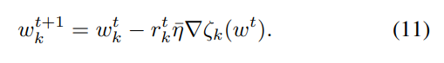
LOCAL CLIENTS
Dynamic Learning Step Size

Slide 9
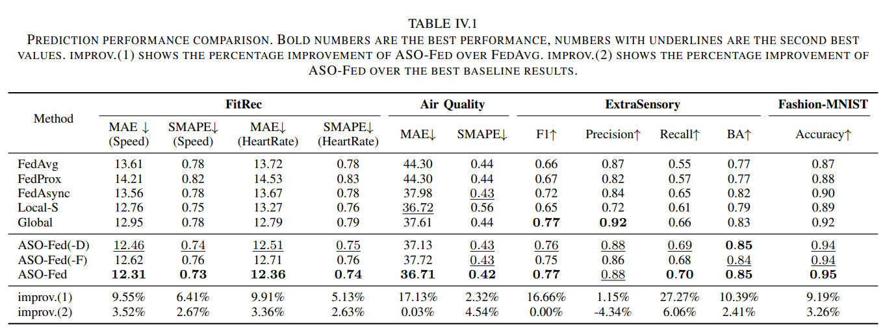
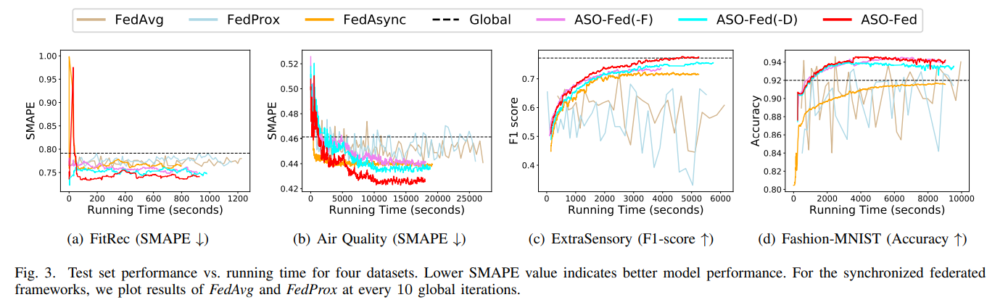
EXPERIMENT
Datasets:
1. FitRec
2. Air Quality
3. ExtraSensory
4. Fashion MNIST

Slide 10
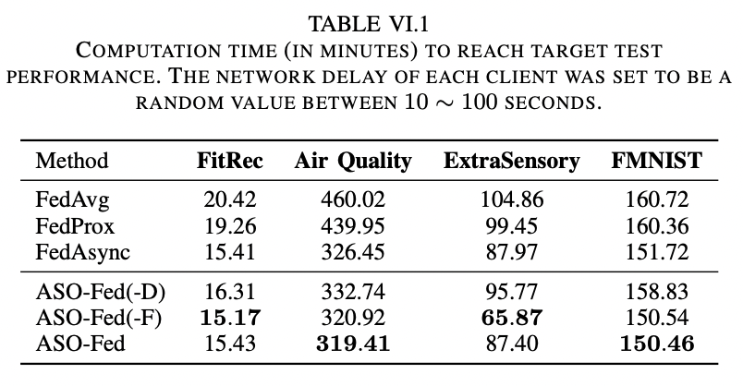
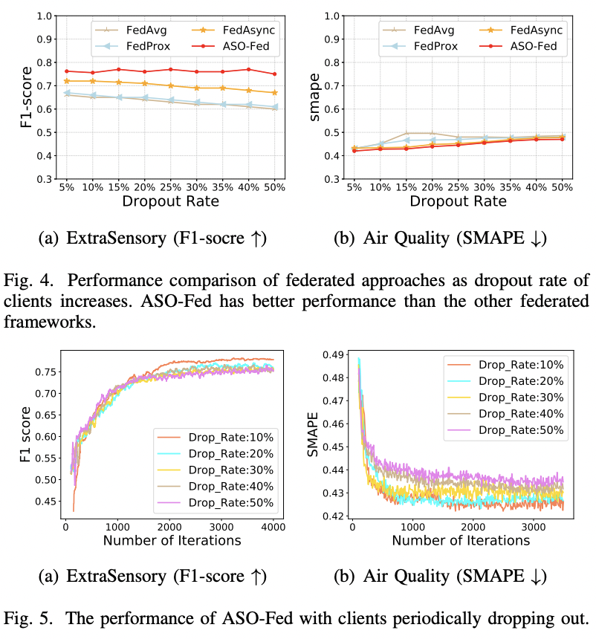
EXPERIMENT

Slide 11
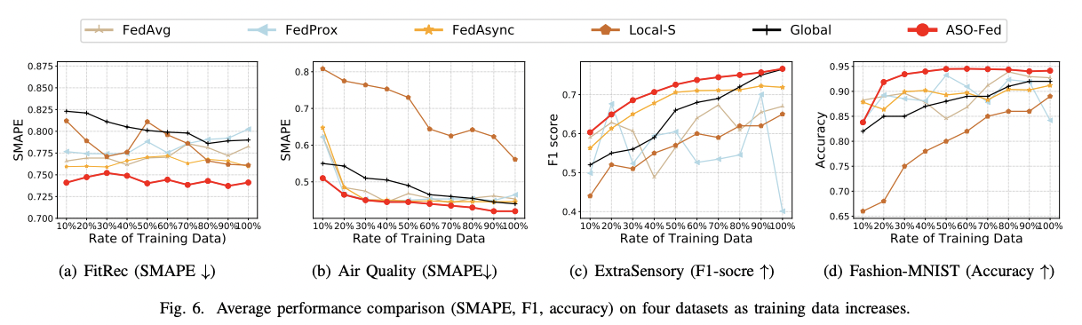
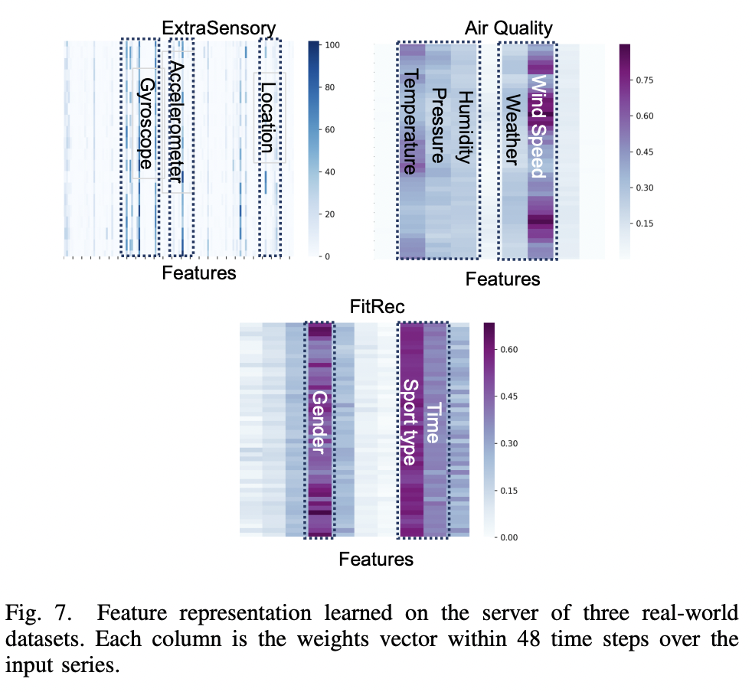
EXPERIMENT

Slide 12
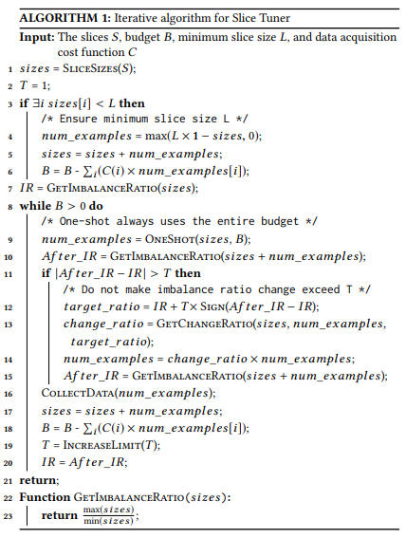
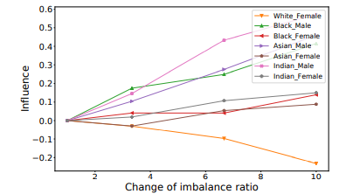
INTUITION
Selective Data Acquistion 알고리즘을 연합 학습에 적용함에 있어, Device간의 상이한 data acquistion cost를 고려하여 모델을 설계할 필요가 존재하며 그에 따른 threshold(learning rate 혹은 imbalance ratio의 limitation) 의 조정도 동적으로 일어나며 client별로 관리되어야할 필요성을 느꼈다.

Slide 13
THANK YOU

